Slide 1
Red Color in Israel Final project
GitHub - https://github.com/adimor1/redColor/
By Adi Mor 206556755

Slide 2
Introduction
Operation “Guardian of the Walls” began on May 10 and lasted 12 days
The alerts were sounded all over the country - From south to north
In a period of one month there were 7078 alerts in Israel
At first glance there seems to be a recurring action pattern in the alerts

Slide 3
My research
Can we predict how many alerts will be at any distance from Gaza?
Can we predict when and where will the next alert be?
04
ML
03
EDA
02
Data Cleaning
01
Data Acquisition

Slide 4
Data sources
National Emergency Portal
1
https://www.oref.org.il/12481-he/Pakar.aspx
2
Wikipedia
https://he.wikipedia.org/
Central Bureau of Statistics
3
https://www.cbs.gov.il/he/settlements/Pages/default.aspx
2
Tremp
https://www.tremp.co.il/
API
Crawling

Slide 5
National Emergency Portal - API
NAMES
01
I took all the alerts in Israel in the last month
TIMES
02
DATES
03

Slide 6
Wikipedia - Crawling
latitudes
04
For each alert I searched in Wikipedia for the location
longitudes
05
(It was not that simple because locations are often called differently on each platform)
r = requests.get("https://he.wikipedia.org/wiki/" + name(

Slide 7
Central Bureau of Statistics - API
PLACEID
06
For each alert I searched in the Central Bureau of Statistics for more information
DISTRCIT
07
FORMS
08
(It was not that simple because locations are often called differently on each platform …again)
PEOPLE NUMBER
09

Slide 8
Tremp - Crawling
distance
10
For each alert I searched “Tremp” for it’s distance from Gaza

Slide 9
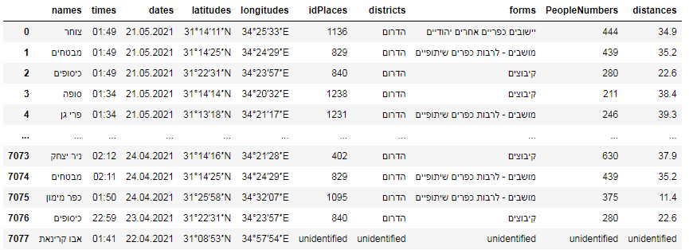
Full data
7078 rows X 10 columns

Slide 10
Data cleaning
Clean name (“, ‘…)
names
Latitudes& longitudes
unidentified
Id = 0 if unidentified
Id Places
districts
unidentified
unidentified
forms
People Numbers
Avg if unidentified
Avg if unidentified
distance

Slide 11
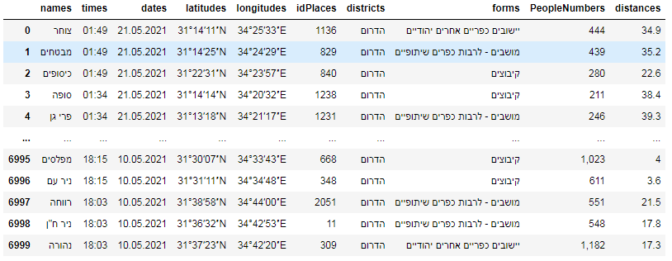
Data after cleaning
7078 rows X 10 columns

Slide 12
Visualization
01
Number of alerts by district
02
Number of alerts by date
03
Number of alerts by time
04
Do most alerts occur on round hours ?
05
Number of alerts by distance

Slide 13
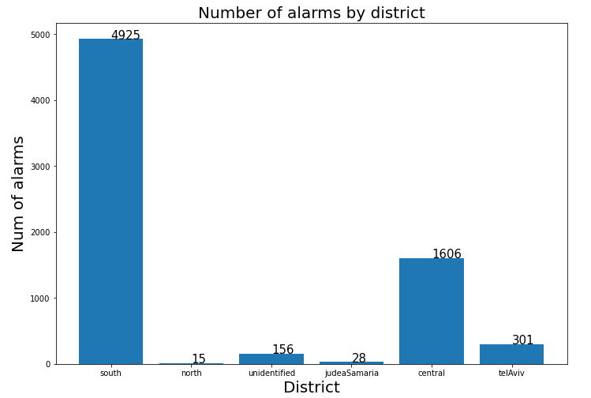
Visualization - 01
In the south there are more than 3 times as many alerts

Slide 14
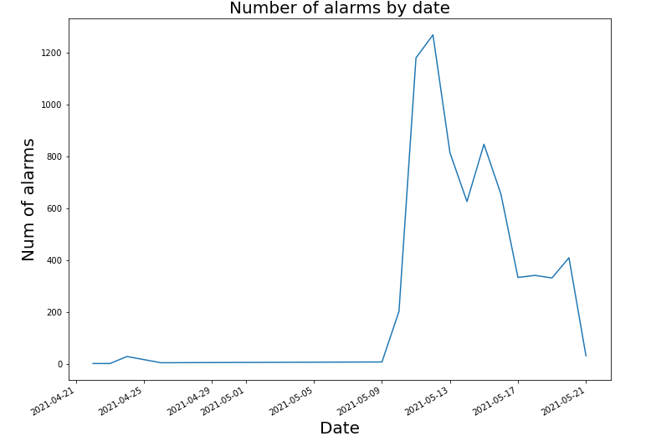
Visualization - 02
The number of alerts increased sharply at the beginning of the operation, and gradually decreased towards the end of the operation

Slide 15
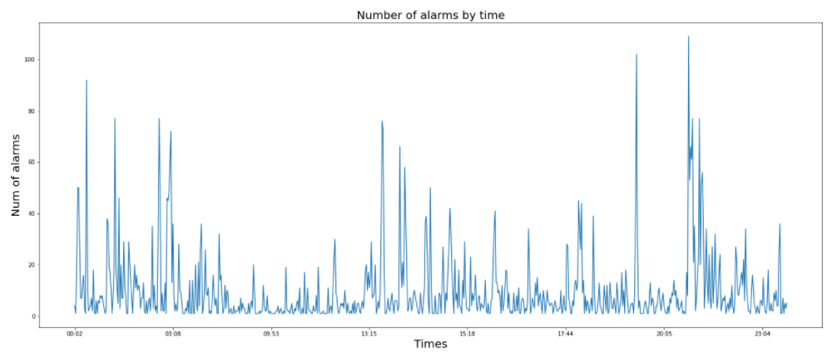
Visualization - 03
1. The peak of the number of alarms is in the evening
2. Between night and noon are the quietest hours

Slide 16
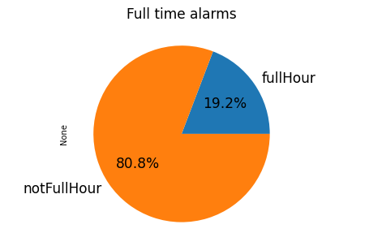
Visualization - 04
There is a high chance of an alert in around round hours (58, 59, 00, 01, 02)

Slide 17
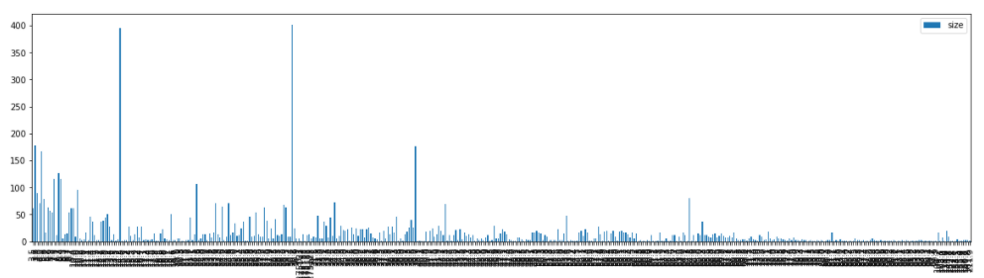
Visualization - 05
There is a linear relationship between the distance of the city from Gaza and the amount of alerts sounded in it during the operation (Large cities in central and southern Israel excluded)

Slide 18
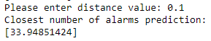
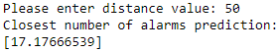
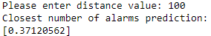
ML - logistic regression
Using “sklearn” library and linear regression I was able to train a model that predicts the number of alerts in the next operation for each distance from Gaze
Close distance
01
Average distance
02
Long distance
03

Slide 19
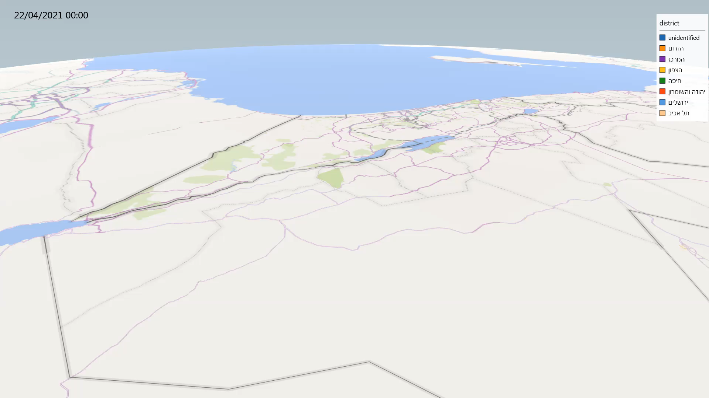
Bonus

Slide 20
THANKS FOR WATCHING

